Slide 1


SMART WATER METER
PROJECT SUBMITTED IN PARTIAL FULFILLMENT OF THE REQUIREMENT FOR THE DEGREE OF
BACHELOR OF TECHNOLOGY
IN ELECTRONICS AND COMMUNICATION ENGINEERING
FUTURE INSTITUTE OF TECHNOLOGY
PROJECT GUIDE :
Prof. Rupa Das
Faculty member, Electronics And Communication Engineering

Slide 2
MEMBERS
ROLL NUMBER | NAME
34200320004 | VAIBHAV SINHA
34200320006 | SHAUNAK BISWAS
34200320012 | SOMALI SIKDAR
34200321001 | MRINMOY GHOSH

Slide 3
CONTENT
Sl No. | Topic | Slide No.
1. | INTRODUCTION | 4
2 | LITERATURE REVIEW | 5
3. | PROBLEM STATEMENT | 6
4. | PROPOSED SOLUTION | 7
5. | COMPONENT & TENTATIVE BUDGET | 8
6. | BLOCK DIAGRAM | 9
7. | CIRCUIT DIAGRAM | 10
8. | DATABASE | 11
9. | WEBSITE | 12
10. | ADVANTAGES & DISADVANATGES | 13
11. | CONCLUSION | 14
12. | REFERENCE | 15

Slide 4
INTRODUCTION
In our day-to-day life, the waste of water is one of the significant problems.
With the increase in population, there is a rapid increment in cases of shortage of water. With some problems being so common in these cases, our team has decided to work on it as our project of ‘Smart Water Meter’.
To start with, we have taken our first step by going through some thesis papers to get a good idea of the most frequent problems in the world of water management. And we have tried to provide a possible solution to some major problems in our project.

Slide 5
LITERATURE REVIEW
Serial No. | Journal/Paper | Author | Publishing Year | Comment
1. | IoT BASED WATER FLOW MONITORING AND CONTROLLING SYSTEM | Shirish Satpute, Dipali Khadap , Shanta Khairate , Prof. Dr. Anagha Kunte | 2019 | Utilizing IoT to address water wastage, enhancing monitoring, control, and efficiency in water resource management.
2. | Design and Development of Water Flow Network using IoT | Rajashree., Shankari N. | 2019 | facilitates equitable water distribution via IoT, minimizing wastage and ensuring efficient consumption tailored to individual needs in densely populated urban settings.
3. | IoT based Water Monitoring and Alerting System | D. Ram Pralad, B. Harinath Reddy, G. Naveen Varma, V. Sai Kiran , Shobharani D.A5 | 2020 | Enables real-time monitoring and precise billing, promoting efficient water usage and conservation.

Slide 6
PROBLEM STATEMENT
Statement 1: Lack of effective means to monitor and manage water consumption in real time.
Statement 2: The absence of a reliable method to measure water usage leading to inefficiencies and
potential wastage.
Statement 3: Limited tank level monitoring.
Statement 4 : Automated alerting for threshold exceedance.
Statement 5 : Lack of access to historical water usage data for analysis and decision – making.
Statement 6 : Absence of immediate alerts or notification for users in case of critical water usage events
or emergencies .

Slide 7
PROPOSED SOLUTION
Proposed Solutions
Real time monitoring
Alert system
Historical data storage
Remote control

Slide 8
COMPONENTS & TENTATIVE BUDGET
Sl No. | Components | Tentative Cost
1. | Water Flow Sensor | 150
2. | NodeMCU | 150
3. | Ultrasonic Sensor | 60
4. | DC Power Adaptor | 120
5. | Mounting Hardware | 250
6. | Jumper wires, Connectors | 50
7. | Bread Board | 120
Total 900

Slide 9
BLOCK DIAGRAM
NodeMcu
Ultrasonic
Sensor
Tank
Water flow
sensor
Inlet Pipe
Firebase
Website

Slide 10
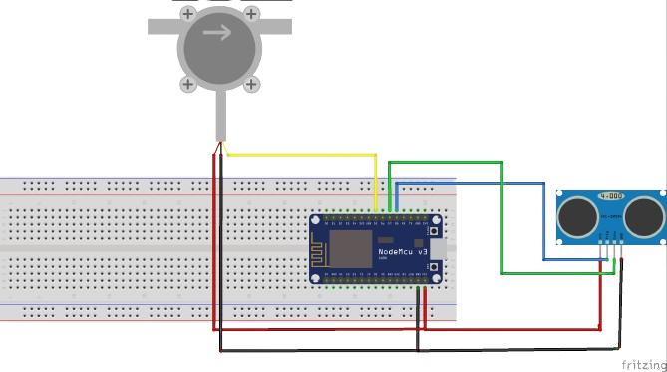
CIRCUIT DIAGRAM
Water Flow Sensor
Ultrasonic Sensor
Nodemcu

Slide 11
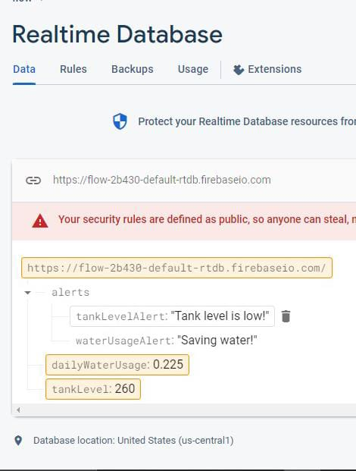
DATABASE

Slide 12
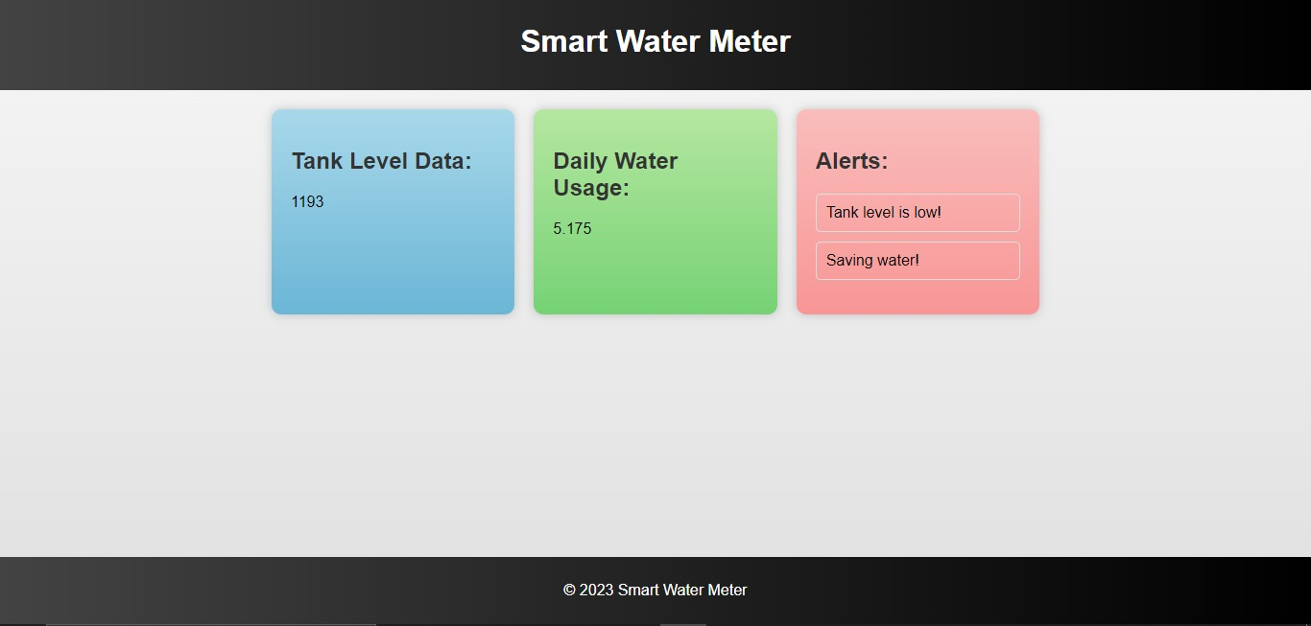
WEBSITE

Slide 13
ADVANTAGES
Immediate detection of anomalies.
User awareness and behaviour modification.
Optimizing resource allocation.
DISADVANATAGES
Initial implementation cost.
Maintenance and upkeep
Dependency on internet connectivity

Slide 14
CONCLUSION
The project embarks on a transformative journey toward revolutionizing water management practices. By addressing existing challenges such as inadequate alert systems and insufficient user engagement, it sets a course for a future that embraces innovation.
The envisioned integration with smart devices for SMS notifications and the implementation of an SMS alert system signifies a pivotal shift toward real-time user engagement, empowering individuals to make informed decisions about their water usage.
The prospect of predictive analytics and community-driven initiatives embodies a proactive approach, ensuring not just immediate responses but fostering a culture of collective awareness and action.

Slide 15
REFERENCES
Satpute, S., Khadap, D., Khairate, S., & Kunte, A. (2019-20). IoT Based Water Flow Monitoring and Controlling System. *International Journal of Advance Scientific Research and Engineering Trends*, 4(Special Issue 12), 1-5. ISSN: 2456-0774.
Rajashree., & Shankari, N. (2019). Design and Development of Water Flow Network using IoT. International Journal of Recent Technology and Engineering (IJRTE), 8(3), 81. ISSN: 2277-3878.
D. Ram Pralad, B. Harinath Reddy, G. Naveen Varma, V. Sai Kiran, Shobharani D.A. "IoT based Water Monitoring and Alerting System." *International Journal of Advanced Trends in Computer Science and Engineering,* vol. 9, no. 2, March - April 2020, pp. 1762–1766.

Slide 16
THANK YOU

